Slide 1
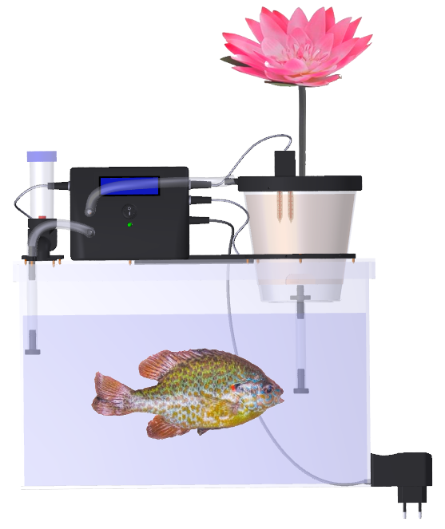
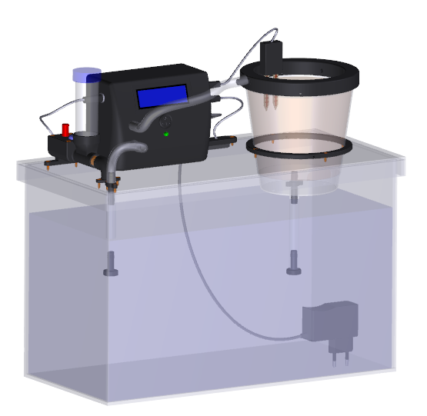
Mini Aquaponic System

Slide 2
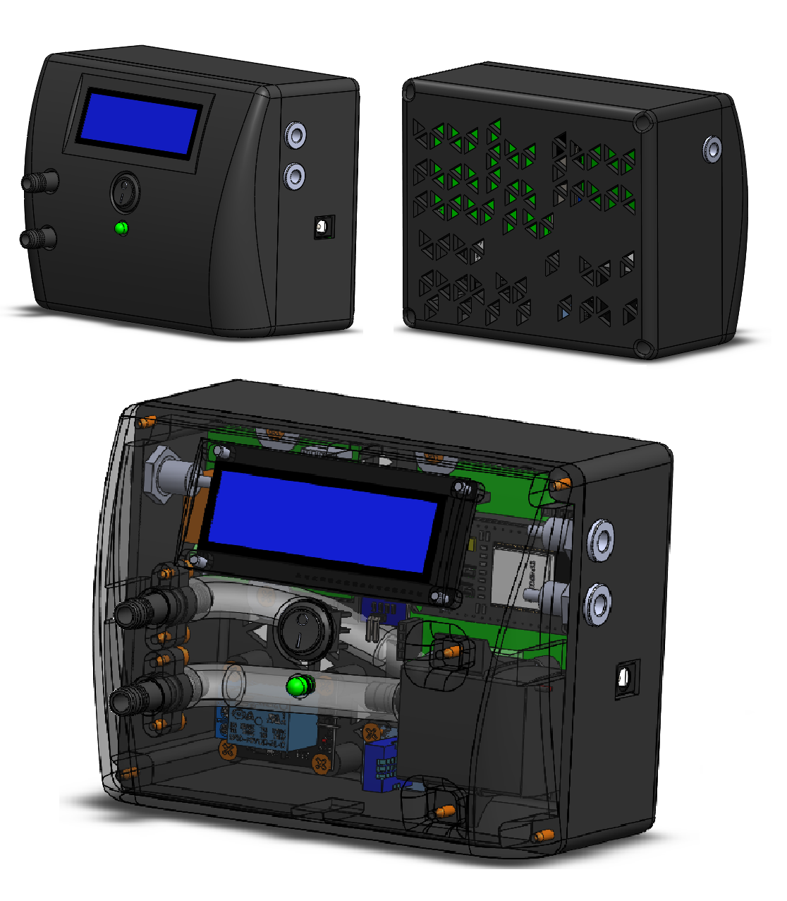
Automatic device
- LCD I2C 1602.
- Switch button.
- LED.
- DC pump.
- 2 channel relay module .
- 1 channel relay module.
- DHT11 temp. and humidity sensor.
- Resistor 330 Ω.
- IR tracker sensor module.
- ESP 32.
- MCU PCB.

Slide 3
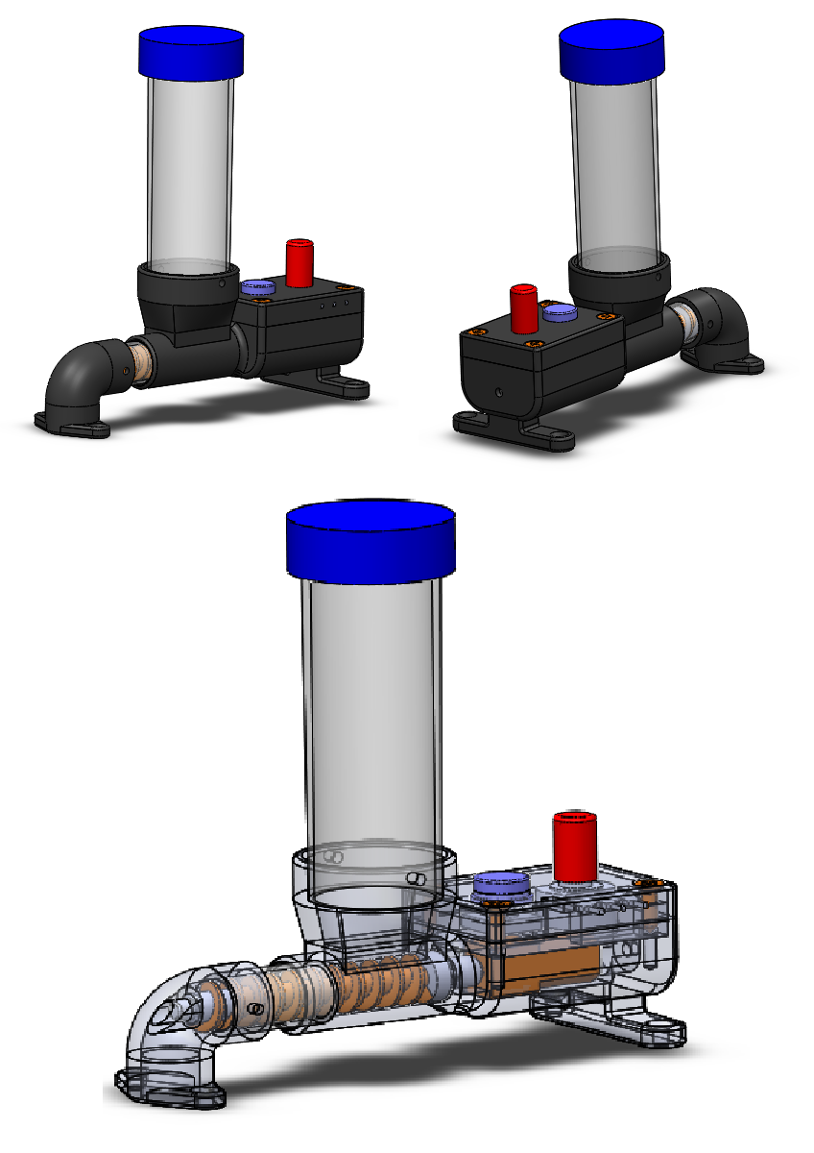
Fish feeder
- DC motor with gear box.
- Push button.
- Potentiometer.

Slide 4
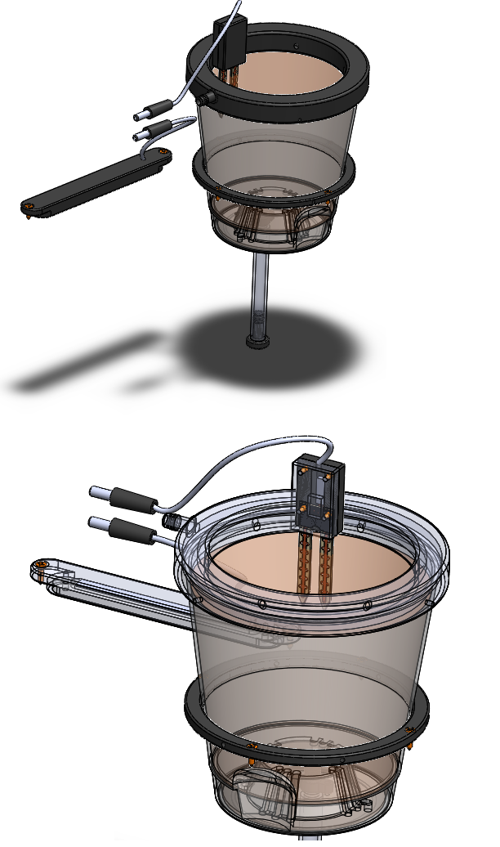
Peripheral devices and sensor
- Soil moisture sensor.
- LED bar.

Slide 5
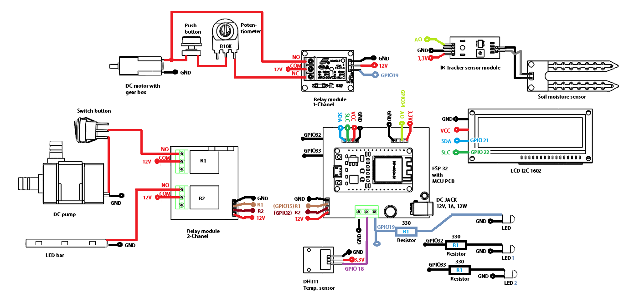
Circuit Diagram

Slide 6
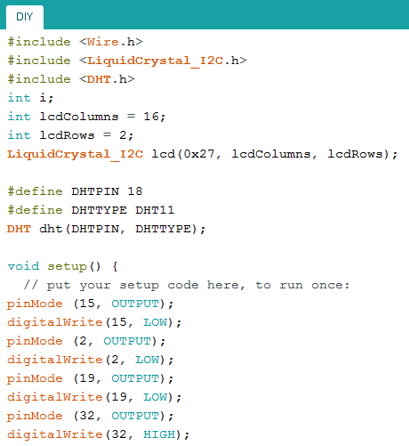
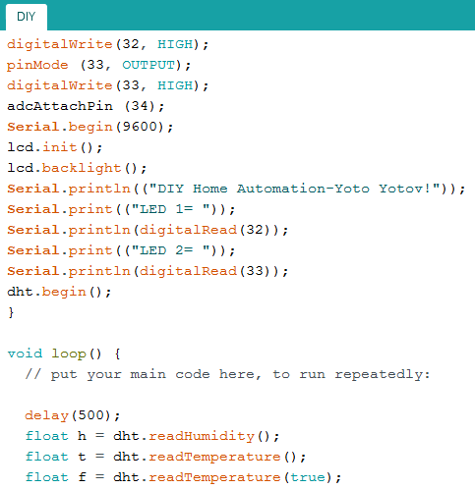
Source code

Slide 7
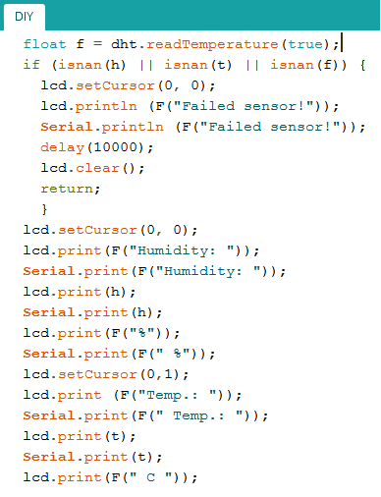
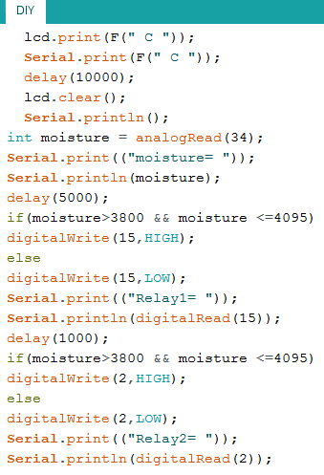
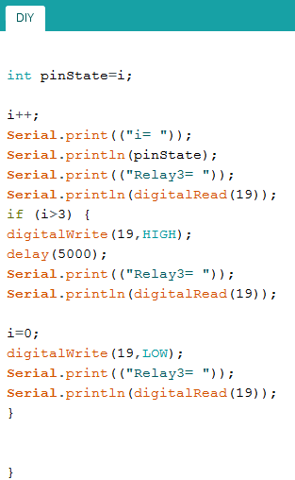
Source code

Slide 8
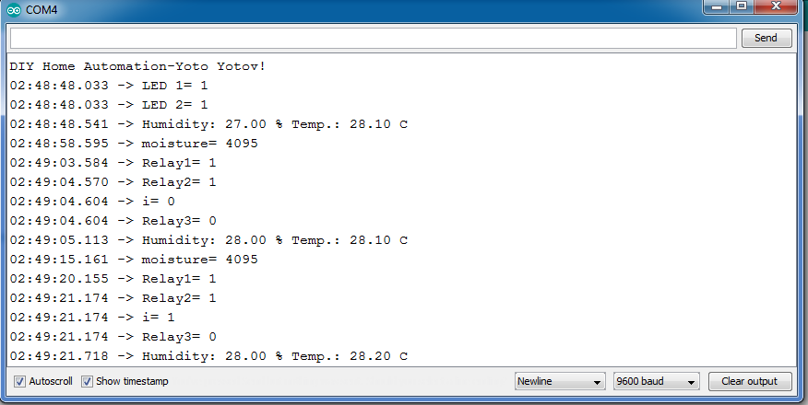
Result

Slide 9
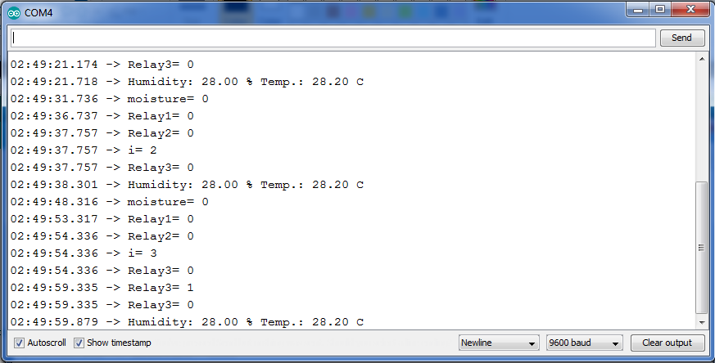
Result

Slide 10
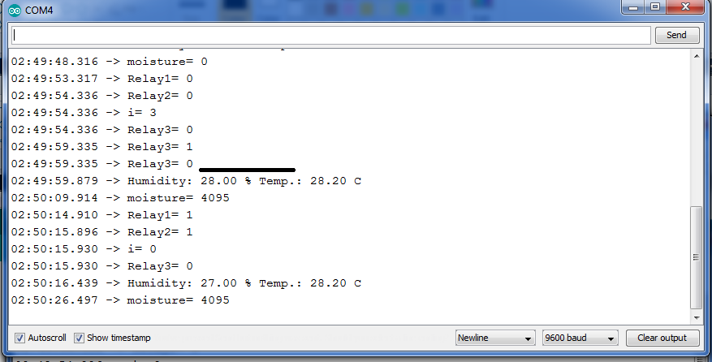
Result

Slide 11

Thank you for your attention!
3D Models
https://grabcad.com/library/mini-aquaponic-system-and-fish-feeder-1
Source code
https://github.com/Yoto7/MiniAquaponicSystem

